Slide 1

Cyber Security Activity (Group A) Man-In-The-Middle Attacks

Slide 2
Members 1. Atharva Shah 2. Anay Deshpande 3. Atharva Shiurkar 4. Nikhil Haswani 6. Rashmi Kamble 7. Lavesh Milani 8. Om Khulbe

Slide 3
Definition
Since the 1980s, MitM attacks have been used to infiltrate traffic between innocent parties.
Man-in-the-Middle (MitM) attacks happen when traffic between two parties is observed or manipulated by an unknown third party.
A MitM attack is a cybercrime method used to steal personal information or login credentials. Cyber criminals also use MitM attacks as a means to spy on, corrupt information, or disrupt communications between two parties.
Methods
Man-in-the-Middle attacks can happen in a number of ways:
Types of Spoofing (IP, DNS, HTTPS)
Hijacking (Secure Socket Layer, Email)
Wi-Fi Eavesdropping
Theft of Browsing Cookies
Notes:
References:
https://us.norton.com/internetsecurity-wifi-what-is-a-man-in-the-middle-attack.html
https://www.csoonline.com/article/3340117/what-is-a-man-in-the-middle-attack-how-mitm-attacks-work-and-how-to-prevent-them.html

Slide 4
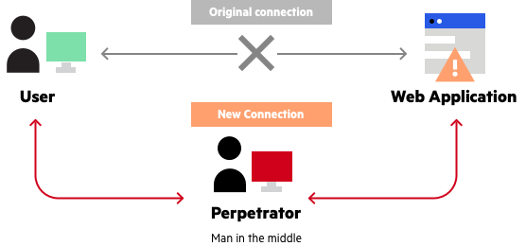
Man-in-the-Browser:
Phishing is a method of sending fraudulent emails or text messages to trick a user into revealing personal information.
When a Man-in-the-Browser attack takes place, the attacker uses a Phishing method in order to administer malware to a device.
Malware is software meant to damage a network, server or personal computer.
A Man-in-the-Browser attack happens when malware installs itself on a victim’s browser in order to record information sent between targeted websites and the user.
Online banking institutions are prone to this form of cybercrime.
Notes:
References:
https://us.norton.com/internetsecurity-wifi-what-is-a-man-in-the-middle-attack.html
https://www.csoonline.com/article/3340117/what-is-a-man-in-the-middle-attack-how-mitm-attacks-work-and-how-to-prevent-them.html

Slide 5
HTTPS Spoofing
HTTPS stands for Hypertext Transfer Protocol Secure. This protocol is used by the Web to format and transmit messages.
Ensure that when visiting a website, the URL indicates that it uses “https” rather than “http”.
In HTTPS Spoofing, the attacker manipulates the browser into believing it is visiting a trusted website.
After redirecting your browser, the attacker uses the vulnerable website to monitor communication and steal shared information.
Notes:
References:
https://us.norton.com/internetsecurity-wifi-what-is-a-man-in-the-middle-attack.html
https://www.csoonline.com/article/3340117/what-is-a-man-in-the-middle-attack-how-mitm-attacks-work-and-how-to-prevent-them.html

Slide 6
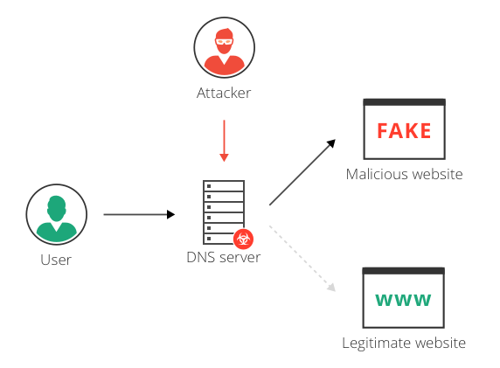
SSL Hijacking
SSL stands for Secure Sockets Layer, which was a protocol developed in order to communicate over the internet securely.
Sometimes when a device visits an unsecure website (http), it is automatically redirected to the secure version (https).
An attacker utilizes a computer and secure server to reroute information of a user right before connection to a legitimate server, this is SSL Hijacking.
Notes:
References:
https://us.norton.com/internetsecurity-wifi-what-is-a-man-in-the-middle-attack.html
https://www.csoonline.com/article/3340117/what-is-a-man-in-the-middle-attack-how-mitm-attacks-work-and-how-to-prevent-them.html

Slide 7
Email Hijacking
Email Hijacking occurs when attackers target financial organizations for email information.
After obtaining access to email accounts, attackers can monitor all financial transactions.
Attackers then follow up by “spoofing” the financial institution’s email and possibly providing users with instructions that would result in the attacker receiving funds.
Notes:
References:
https://us.norton.com/internetsecurity-wifi-what-is-a-man-in-the-middle-attack.html
https://www.csoonline.com/article/3340117/what-is-a-man-in-the-middle-attack-how-mitm-attacks-work-and-how-to-prevent-them.html
https://unit42.paloaltonetworks.com/threat-brief-conversation-hijacking-spear-phishing/

Slide 8
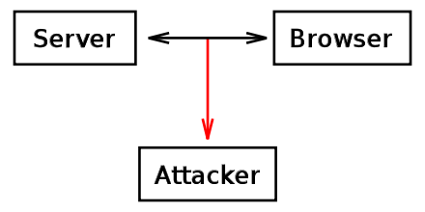
Browser Cookies
A browser cookie is a small piece of data stored by the user’s web browser. This data is used to track browsing sessions.
If browsing data is stored in a cookie and the browser cookie is hijacked, cybercriminals may be able to gain passwords, addresses and other sensitive information.
Notes:
References:
https://us.norton.com/internetsecurity-wifi-what-is-a-man-in-the-middle-attack.html
https://www.csoonline.com/article/3340117/what-is-a-man-in-the-middle-attack-how-mitm-attacks-work-and-how-to-prevent-them.html
https://www.wikiwand.com/en/HTTP_cookie

Slide 9
Protection
Ensure that the browser is using “https” when browsing the web.
Be on alert of Phishing emails that request credentials to be updated.
Refrain from connecting to public Wi-Fi connections without a VPN.
Make use of internet security applications to thwart MitB attacks.
Notes:
References:
https://us.norton.com/internetsecurity-wifi-what-is-a-man-in-the-middle-attack.html
https://www.csoonline.com/article/3340117/what-is-a-man-in-the-middle-attack-how-mitm-attacks-work-and-how-to-prevent-them.html

